Slide 1
Introduction to Microservices Architecture
Notes:
https://dotnet.microsoft.com/learn/aspnet/microservices-architecture – EBook download link

Slide 2
Objectives
What are microservices?
Microservice attribute
Communication in Microservice : Synchronous message and Asynchronous
Why must use Microservice
How a microservice architecture work
Communication in microservices
Microservices ecosystem in ASP.NET Core

Slide 3
What are microservices?
Microservices - also known as the microservice architecture - is an architectural style that structures an application as a collection of services.
Highly maintainable and testable
Loosely coupled
Independently deployable
Organized around business capabilities
Owned by a small team
The microservice architecture enables the rapid, frequent and reliable delivery of large, complex applications. It also enables an organization to evolve its technology stack.

Slide 4
Microservice attributes
Isolated functionality
Isolated data and state
Each service owns its data and its state. It does not share ownership with any other application or part.
Independent deployment
Technology adoption
Consistency and resiliency

Slide 5
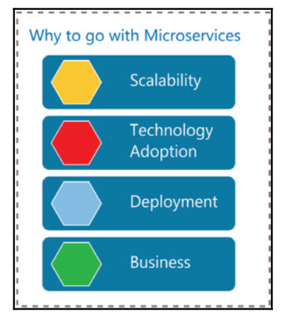
Microservice benefits
Smaller codebase: Each service is small, therefore easier to develop and deploy as a unit
Ease of independent environment: With the separation of services, all developers work independently, deploy independently, and no one is bothered about any module dependencies

Slide 6
Architecting container
Microservice architecture patterns are fundamental pillars when creating a microservice-based application.

Slide 7
Communication in microservices
A microservices-based application is a distributed system running on multiple processes or services, usually even across multiple servers or hosts.
Each service instance is typically a process.
The services must interact using an inter-process communication protocol such as HTTP, AMQP, or a binary protocol like TCP, depending on the nature of each service.

Slide 8
Communication in microservices
Synchronous messaging
When a timely response is expected from a service by a system and the system waits on it till a response is received from the service, it is called synchronous messaging.
REST is one of the most sought-after choices in a microservice architecture. It is simple and supports HTTP request-response, therefore there is no need to look for an alternative.
Asynchronous messaging
When a system is not immediately expecting a response from the service and it can continue processing without blocking the call, it is called as asynchronous messaging.

Slide 9
Communication types - Protocols
Synchronous protocol. HTTP is a synchronous protocol. The client sends a request and waits for a response from the service. That's independent of the client code execution that could be synchronous (thread is blocked) or asynchronous (thread isn't blocked, and the response will reach a callback eventually). The important point here is that the protocol (HTTP/HTTPS) is synchronous and the client code can only continue its task when it receives the HTTP server response.
Asynchronous protocol. Other protocols like AMQP (a protocol supported by many operating systems and cloud environments) use asynchronous messages. The client code or message sender usually doesn't wait for a response. It just sends the message as when sending a message to a RabbitMQ queue or any other message broker.

Slide 10
Communication types - Receivers
Single receiver. Each request must be processed by exactly one receiver or service. An example of this communication is the Command pattern.
Multiple receivers. Each request can be processed by zero to multiple receivers. This type of communication must be asynchronous. An example is the publish/subscribe mechanism used in patterns like Event-driven architecture. This is based on an event-bus interface or message broker when propagating data updates between multiple microservices through events; it's usually implemented through a service bus or similar artifact like Azure Service Bus by using topics and subscriptions.

Slide 11
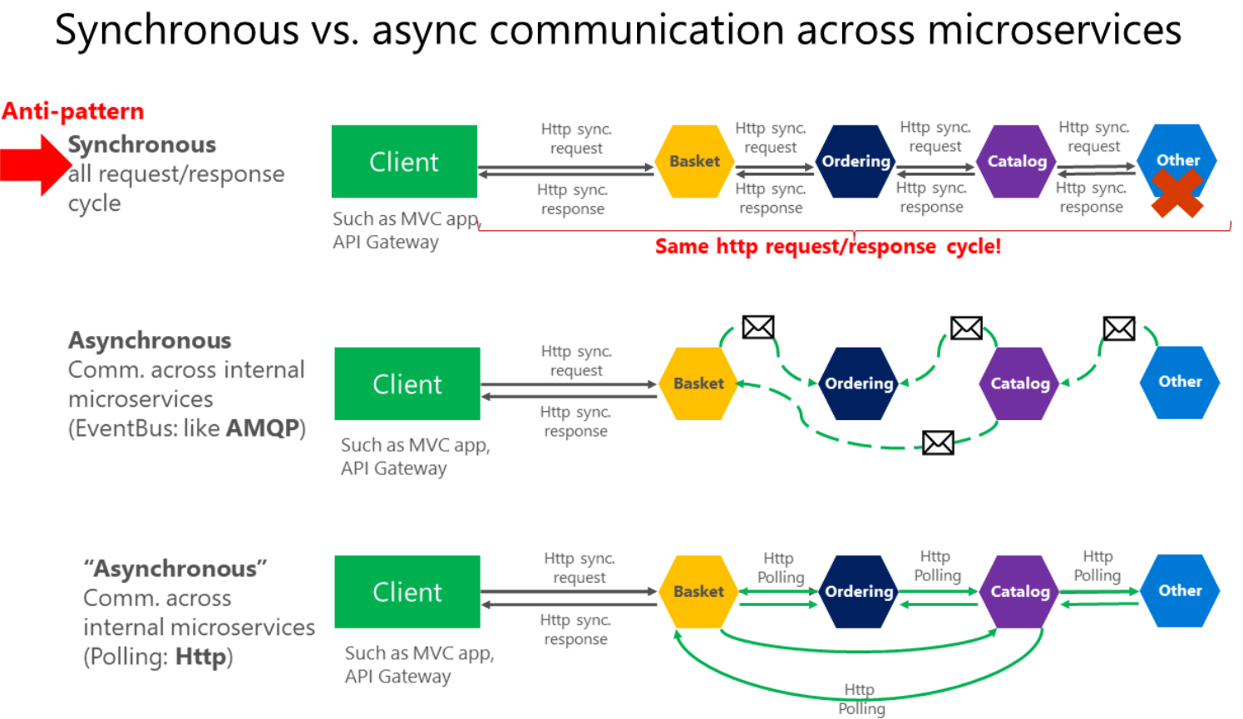
Asynchronous microservice integration - 1
Anti-patterns and patterns in communication between microservices

Slide 12
Asynchronous microservice integration - 2
In synchronous communication a "chain" of requests is created between microservices while serving the client request. This is an anti-pattern.
In asynchronous communication microservices use asynchronous messages or http polling to communicate with other microservices, but the client request is served right away.
If your microservice needs to raise an additional action in another microservice, if possible, do not perform that action synchronously and as part of the original microservice request and reply operation. Instead, do it asynchronously (using asynchronous messaging or integration events, queues, etc.). But, as much as possible, do not invoke the action synchronously as part of the original synchronous request and reply operation.

Slide 13
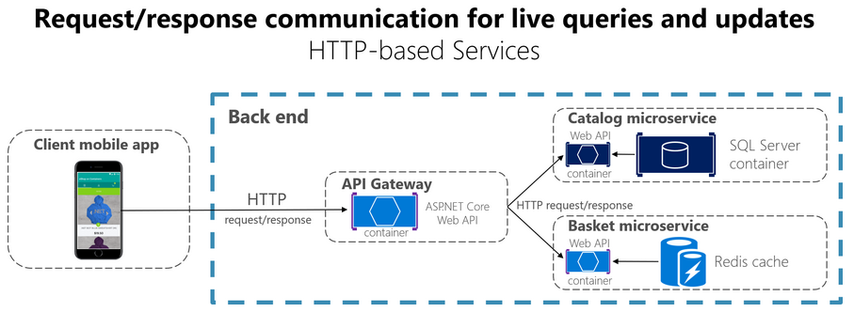
Communication styles - 1
Request/response communication with HTTP and REST

Slide 14
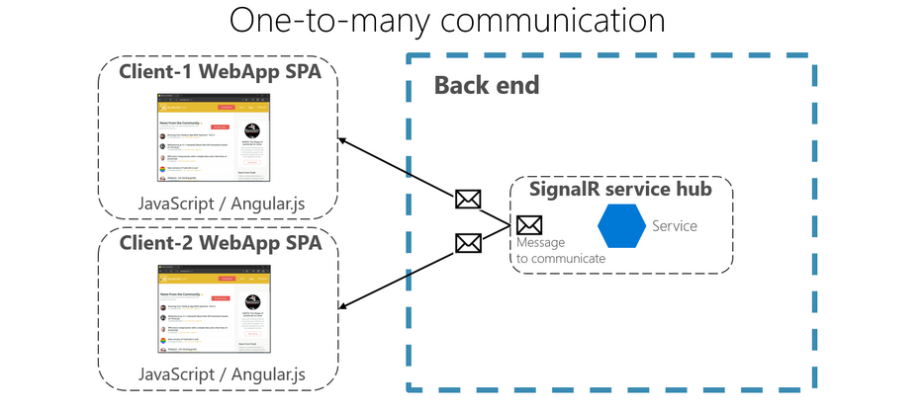
Communication styles - 2
Push and real-time communication based on HTTP

Slide 15
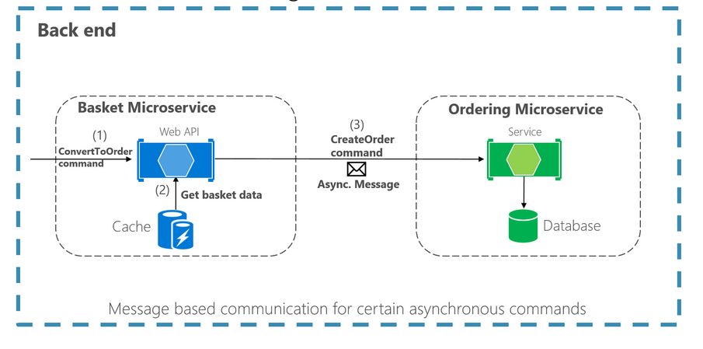
Asynchronous message-based communication
Single-receiver message-based communication

Slide 16
Asynchronous message-based communication
Multiple-receivers message-based communication
As a more flexible approach, you might also want to use a publish/subscribe mechanism so that your communication from the sender will be available to additional subscriber microservices or to external applications.
Thus, it helps you to follow the open/closed principle in the sending service. That way, additional subscribers can be added in the future without the need to modify the sender service.
When you use a publish/subscribe communication, you might be using an event bus interface to publish events to any subscriber.

Slide 17
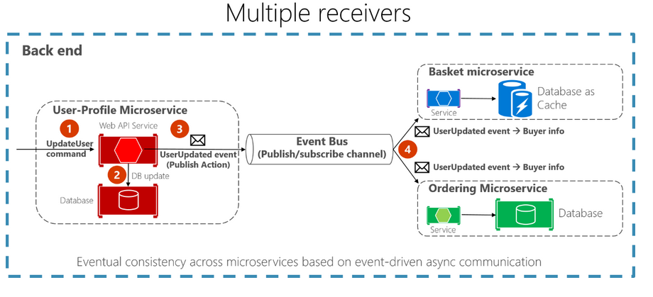
Asynchronous message-based communication
Asynchronous event-driven communication

Slide 18
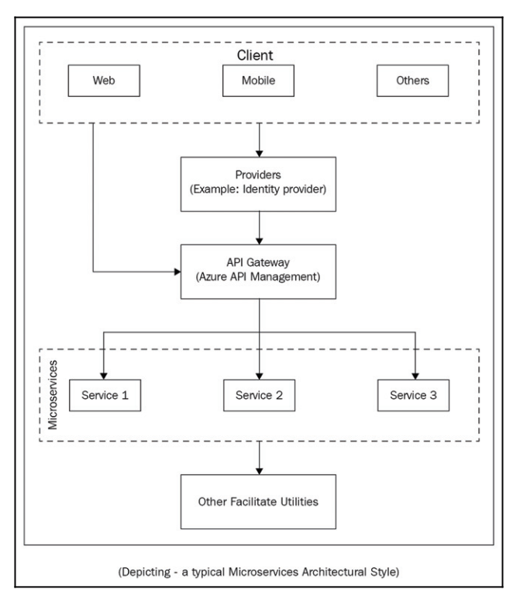
Microservices ecosystem in ASP.NET Core - 1
A typical Microservice architecture style

Slide 19
Microservices ecosystem in ASP.NET Core - 2
Azure Service Fabric - microservice platform
Azure Service Fabric is a distributed systems platform that makes it easy to package, deploy, and manage scalable and reliable microservices and containers.
Stateless and Stateful services - a service programming model.
Stateless: Services do not persist any state between requests from the client. This is the best service programming model when we have external data storage. Our service can be based on a stateless service programming model that interacts and persists data on external database storage.
Stateful: Services maintain a mutable state, actively processing or retaining state data that is specific to the task for which the service is meant.
Communication - a way to exchange data between services

Slide 20
What is Docker?
Docker is an open-source project for automating the deployment of applications as portable, selfsufficient containers that can run on the cloud or on-premises.
Docker is also a company that promotes and evolves this technology, working in collaboration with cloud, Linux, and Windows vendors, including Microsoft.
Docker containers can run anywhere, on-premises in the customer datacenter, in an external service provider or in the cloud, on Azure. Docker image containers can run natively on Linux and Windows.

Slide 21
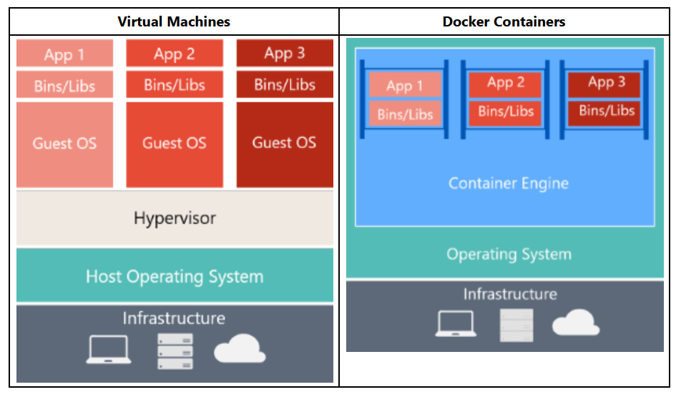
Comparing Docker containers with VM

Slide 22
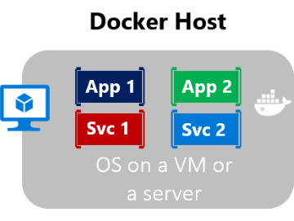
Introduction to Containers and Docker
Containers also isolate applications from each other on a shared OS. Containerized applications run on top of a container host that in turn runs on the OS (Linux or Windows).
Containers therefore have a significantly smaller footprint than virtual machine (VM) images.
Each container can run a whole web application or a service. In this example, Docker host is a container host, and App1, App2, Svc 1, and Svc 2 are containerized applications or services.

Slide 23
.NET for Docker containers
Get Docker Desktop for Windows
Requires Microsoft Windows 10 Professional or Enterprise 64-bit, or Windows 10 Home 64-bit with WSL 2.
For more information, visit the link: https://hub.docker.com/editions/community/docker-ce-desktop-windows

Slide 24
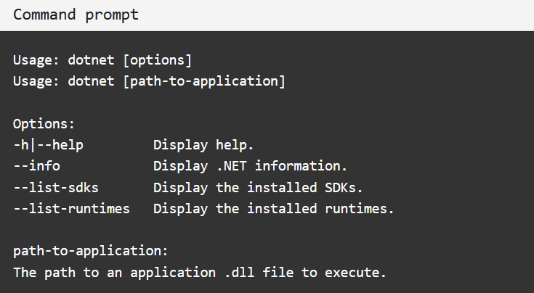
Building a Microservice with ASP.NET Core - 1
Install .NET SDK
To start building .NET apps, download and install the .NET SDK (Software Development Kit). Check everything installed correctly

Slide 25
Building a Microservice with ASP.NET Core - 2
Create your service
dotnet new webapi -o MyMicroservice --no-https -f net5.0
The dotnet command creates a new application of type webapi (that's a REST API endpoint).
The -o parameter creates a directory named MyMicroservice where your app is stored.
The --no-https flag creates an app that will run without an HTTPS certificate, to keep things simple for deployment.

Slide 26
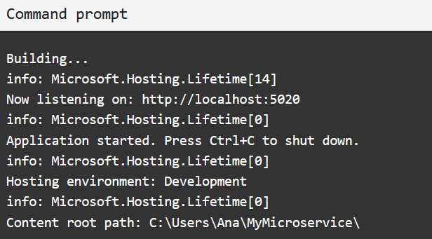
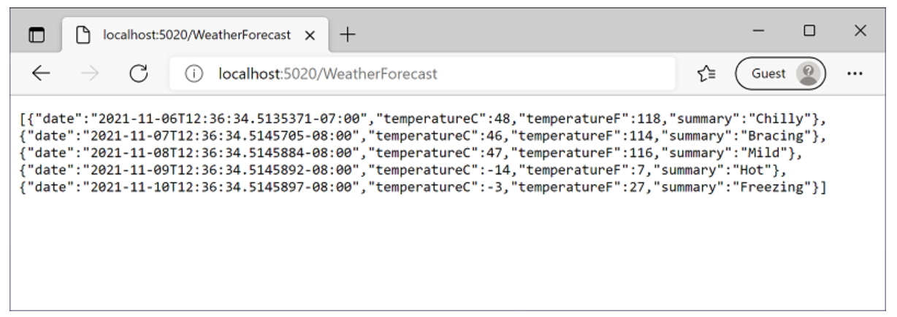
Building a Microservice with ASP.NET Core - 3
Run your service
dotnet run

Slide 27
Building a Microservice with ASP.NET Core - 4
Install Docker
Docker is a platform that enables you to combine an app plus its configuration and dependencies into a single, independently deployable unit called a container.
Check that Docker is ready to use command: docker --version

Slide 28
Building a Microservice with ASP.NET Core - 5
Add Docker metadata
To run with Docker Image, you need a Dockerfile — a text file that contains instructions for how to build your app as a Docker image. A docker image contains everything needed to run your app as a Docker container.
fsutil file createnew Dockerfile 0
start Dockerfile
FROM mcr.microsoft.com/dotnet/sdk:5.0 AS build
WORKDIR /src
COPY MyMicroservice.csproj .
RUN dotnet restore
COPY . .
RUN dotnet publish -c release -o /app
FROM mcr.microsoft.com/dotnet/aspnet:5.0
WORKDIR /app
COPY --from=build /app .
ENTRYPOINT ["dotnet", "MyMicroservice.dll"]

Slide 29
Building a Microservice with ASP.NET Core - 6
Create Docker image
Run the following command: docker build -t mymicroservice .
The docker build command uses the Dockerfile to build a Docker image.
The -t mymicroservice parameter tells it to tag (or name) the image as mymicroservice.
The final parameter tells it which directory to use to find the Dockerfile (. specifies the current directory).
Run the command to see a list of all images available on your machine, including the one you just created.
docker images

Slide 30
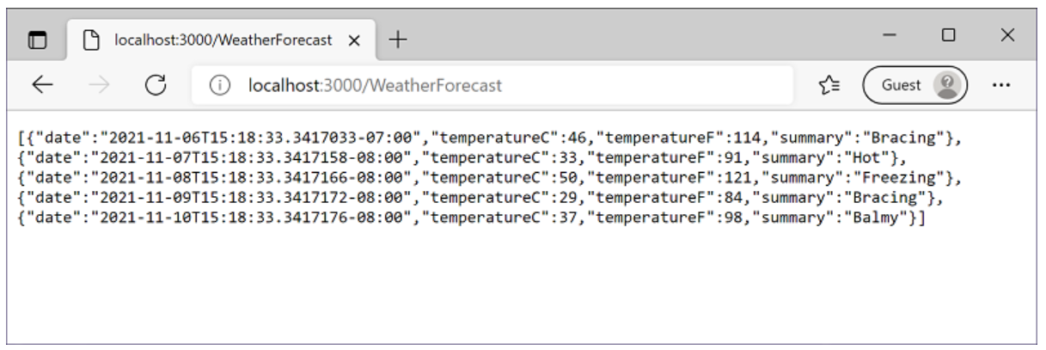
Building a Microservice with ASP.NET Core - 7
Run Docker image
You can run your app in a container using the following command:
docker run -it --rm -p 3000:80 --name mymicroservicecontainer mymicroservice
You can browse to the following URL to access your application running in a container: http://localhost:3000/WeatherForecast

Slide 31
Summary
Concepts were introduced:
What are microservices?
Microservice attribute
Communication in Microservice : Synchronous message and Asynchronous
Why must use Microservice
How a microservice architecture work
Communication in microservices
Microservices ecosystem in ASP.NET Core
Demo: Building a Microservice with ASP.NET Core

